Slide 1

CoinFlip
I know you are going to like this show

Slide 2
What is CoinFlip
An Active Recommendation Engine
That uses mobile technologies in the form of a simple mobile application to gather user preferences / tolerances to key decision making factors
To generate with a high degree accuracy a prediction on weather user will like a live concert or DJ set

Slide 3
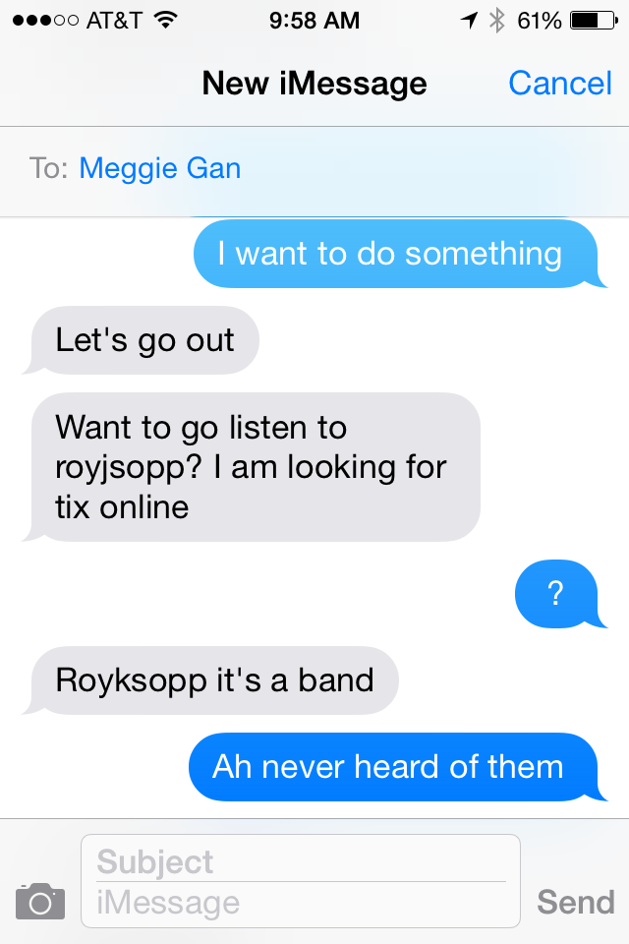
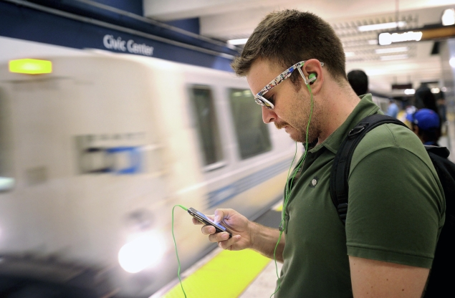
Problem
Problem: Enjoyment of live music is a very personal, it has hard to determine if you are going to like a live concert or DJ set just by recommendations from friends or by web or social media pages.
Generic Use Case: You have been invited to go a live concert by a friend. You want to go but you have no idea who the band or DJ is… How do you know if you will you like the show ?

Slide 4

How does CoinFlip Solve the Problem
Locally Stored Music Information +Social Media Information + Cloud Music Likes + Price Point + Location Torrance
Active Recommendation Algorithm
A prediction delivered to the user with a high degree of confidence if they are going to like a live concert of DJ set or not

Slide 5
Why an Active Recommendation Engine vs. Passive?
Passive Recommendation Engines SUCK!!!!!!!
Why do they suck:
The results often don’t match the users tastes
Often based inaccurate data sets
Product placement can be easily intergraded with product recommendation and
reduces the validity of their results
Uses don’t use they to discover new product or services

Slide 6
Project Market Size
Target Demographic:
Adults 18-44
Target Demographic with mobile phones and applications:
44,141,239
Target Demographic with mobile applications and applications who go live concerts and DJ sets
17,656,495 Users in the U.S.

Slide 7
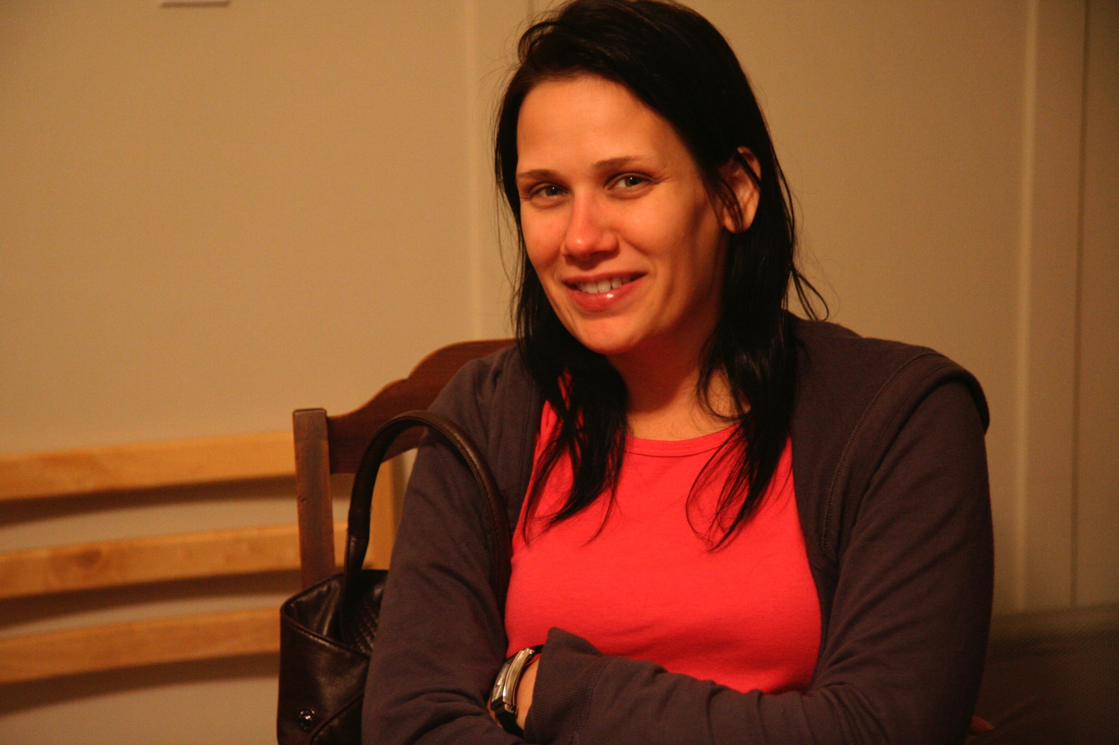
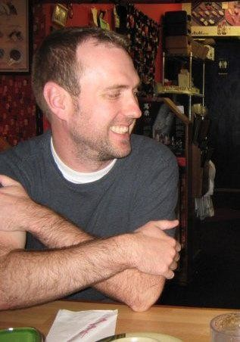
Users Personas
Demographics:
Male or Female
Ages 18-44
Resides in Urban or Suburban areas
Values:
Enjoys going to live shows concerts and or DJ sets
Uses Social Media
Use Mobile Applications to
solve problems in their lives
Janet, 31, works as a traveling nurse
and goes to DJ sets as way to meet
new people
Ben 27, lives in San Francisco
works as a project manger who
enjoys going to concerts to spend time with friends and to discover new music

Slide 8
Trends effecting CoinFlip
More Live Music: The decline of revenue from music purchases
(physical and digital music) as not extended to Live music. The live event and
promotion service Live Nation posted over a billion dollar revenue increased
between the years from 2011 to 2013.
Easy Access to large Social Media data sets: Accesses to Google and Facebook
APIs have acquiring user information relatively easy and develop against
Data Science : Data Science is quickly becoming a standard business practice to
project reverence, examine and predict user behavior, detect growth opportunities
Mobile “ Hyper Connectively” to solve problems: Users are using mobile
application on their mobile devices more and more to solve daily problems.

Slide 9
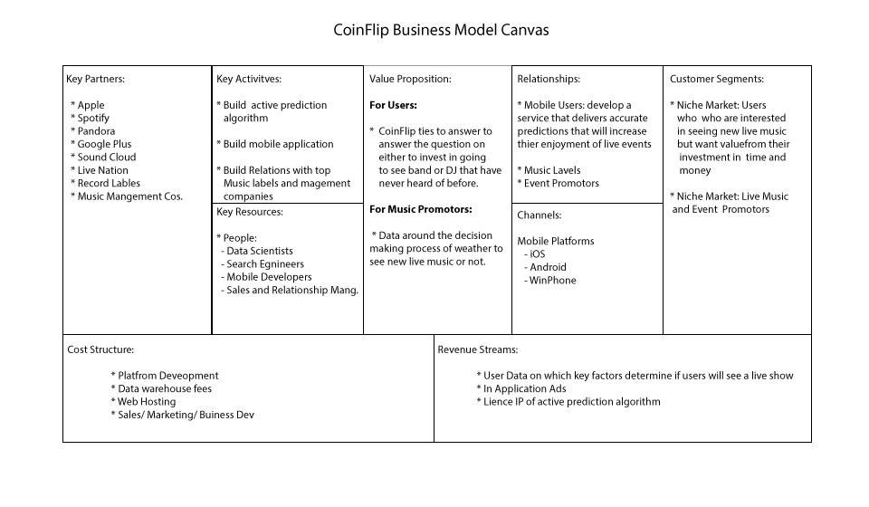
CoinFlip: Business Model Canvas

Slide 10
Risks and MVP
Market Risk. There is no market for the product / users will not use it
Technology Risk The predictive algorithm is too complex and thus it will fail to predict if the end user will like a show in a cost effective manner
Market /Legal Risk User's might object to having their purchasing data mined and not use the app once they find out their personal information is being mined and sold
Hypotheses: People will use an application/service when they don't if they don't know
if they will like a live concert or DJ set or it.
MVP1: Set up a sms service that will allow a select users to ask the question
" will I like this show or not". If they get a "go the show, they will be directed to
fake product page”.
MVP2: Build “simple” version of the active recommendation engine and test the results.
As the results improve, add more complexity and test.

Slide 11

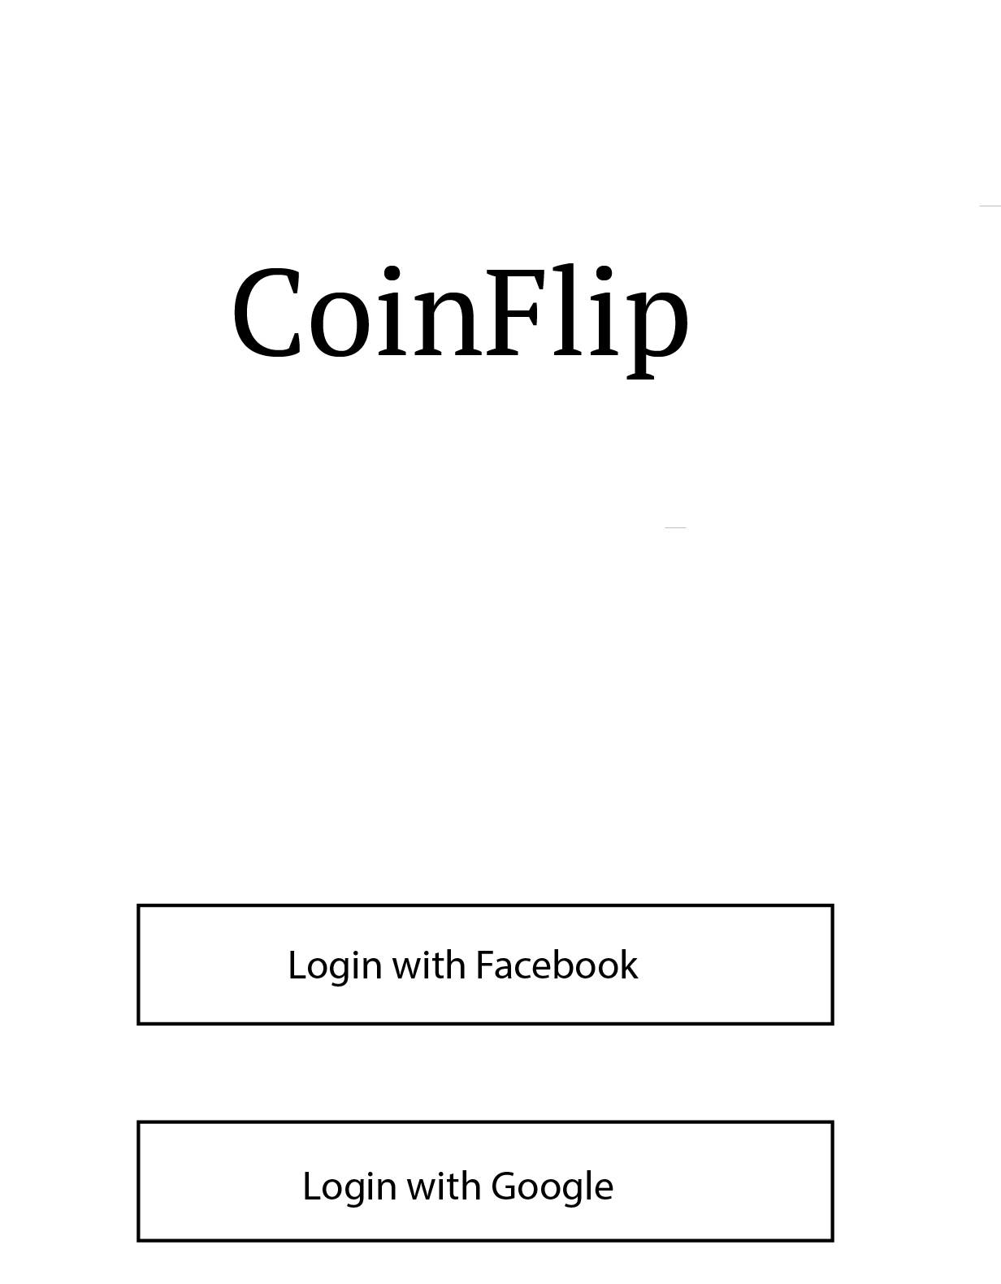
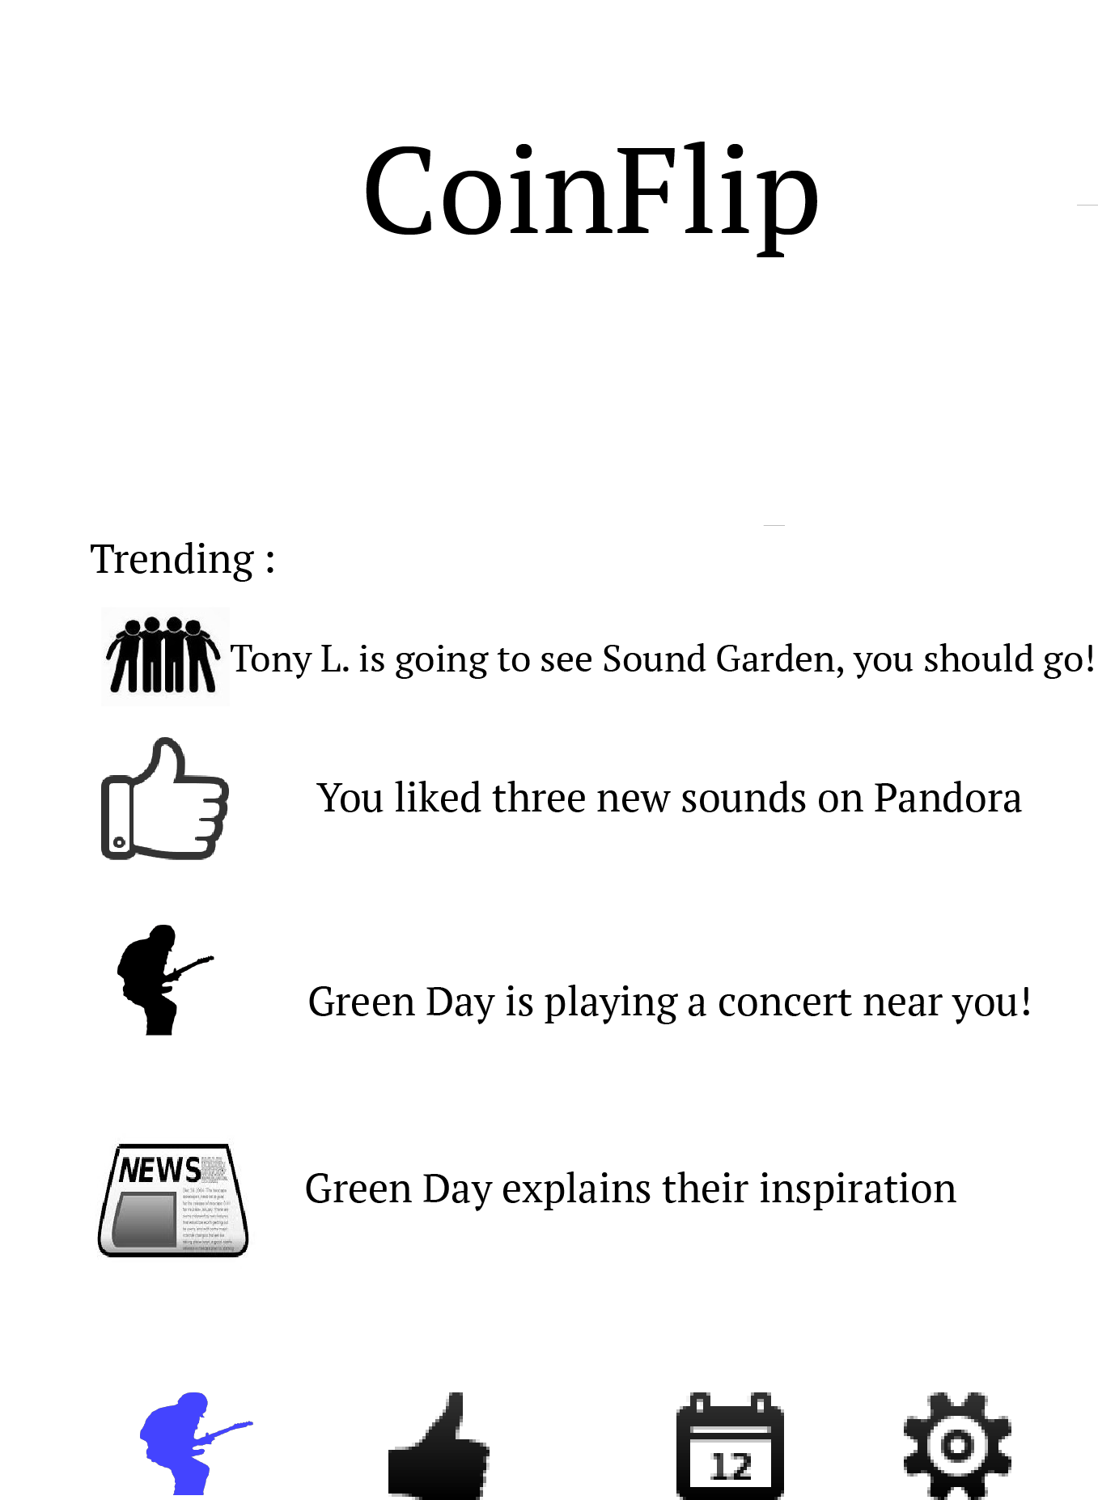
Wire Frames of Key User Flow

Slide 12
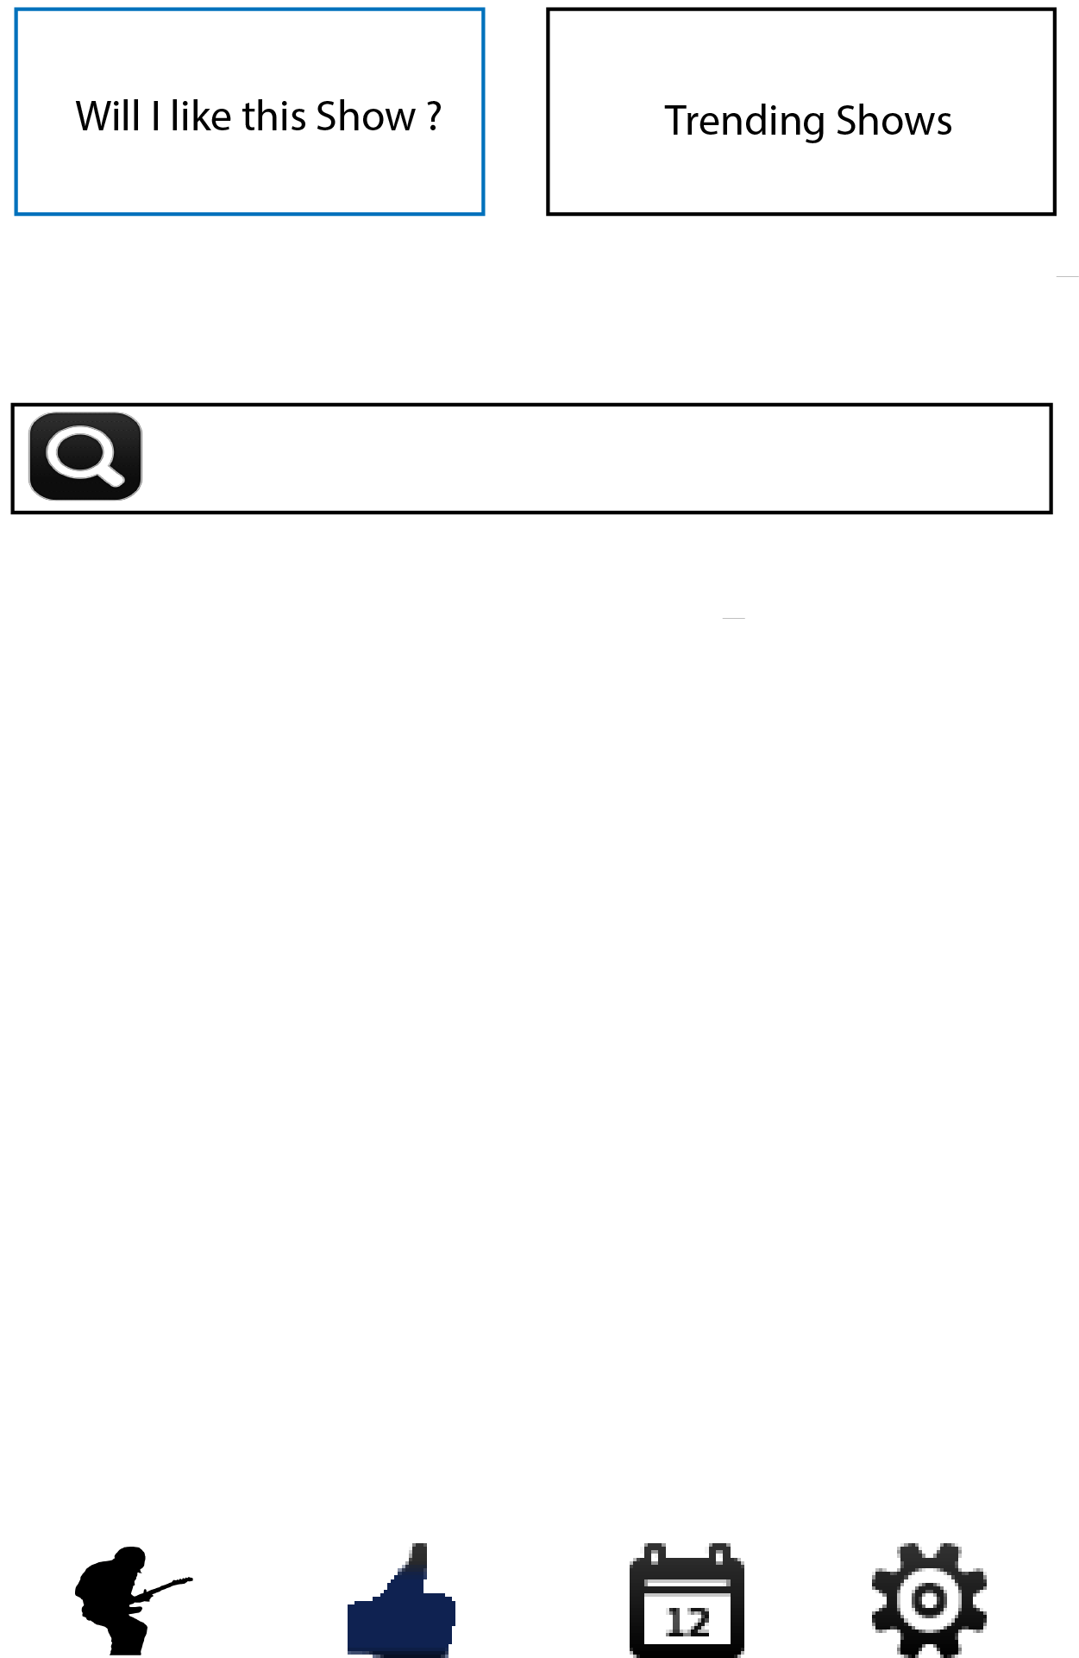
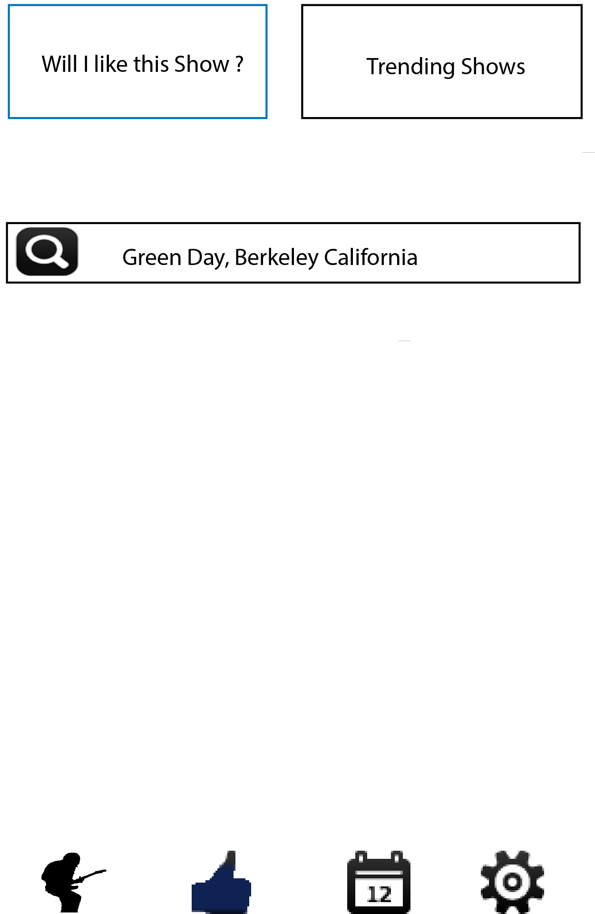
Wire Frames of Key User Flow

Slide 13
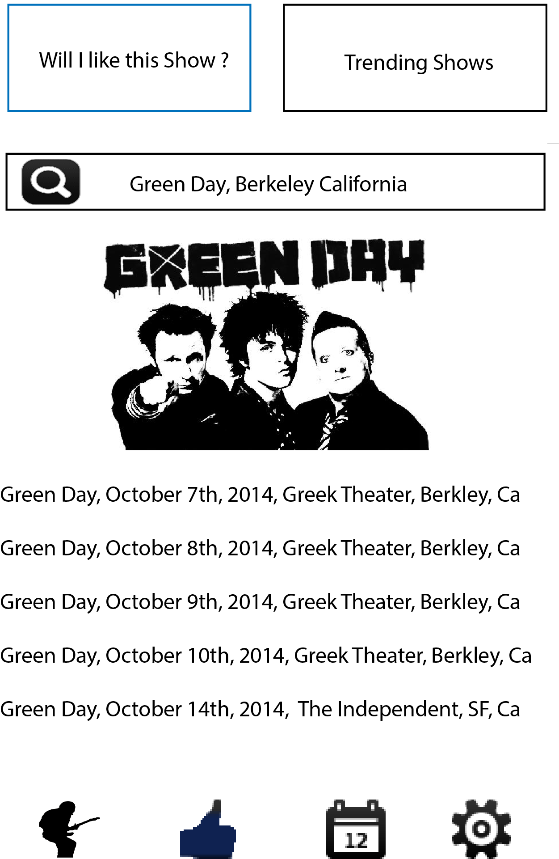
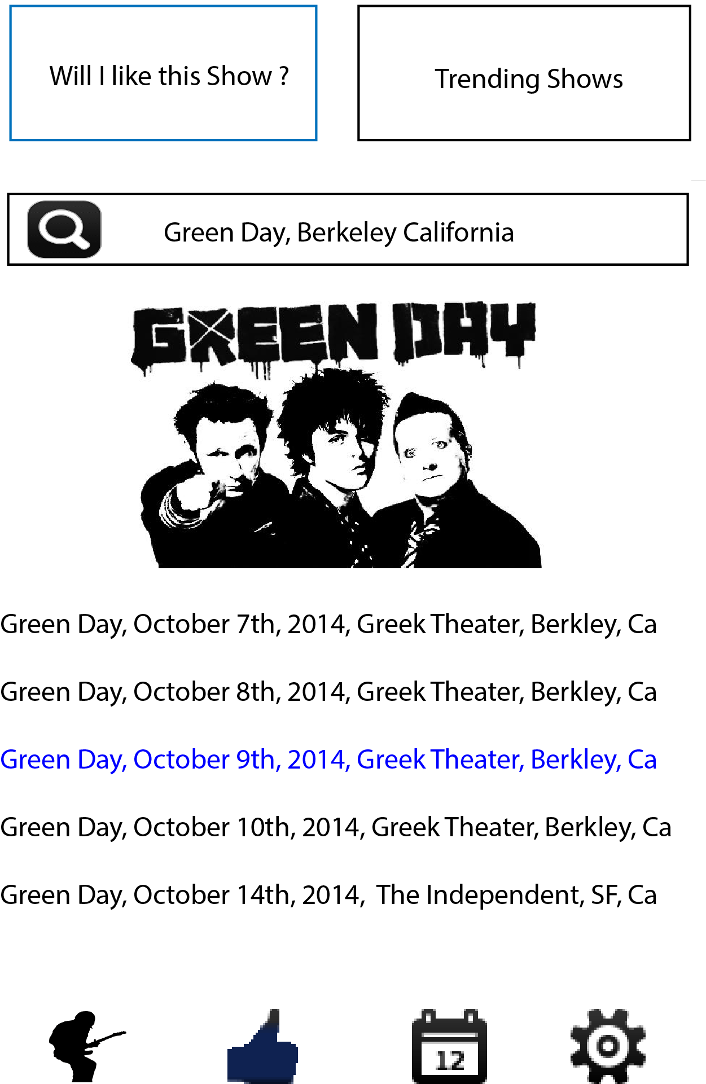
Wire Frames of Key User Flow

Slide 14
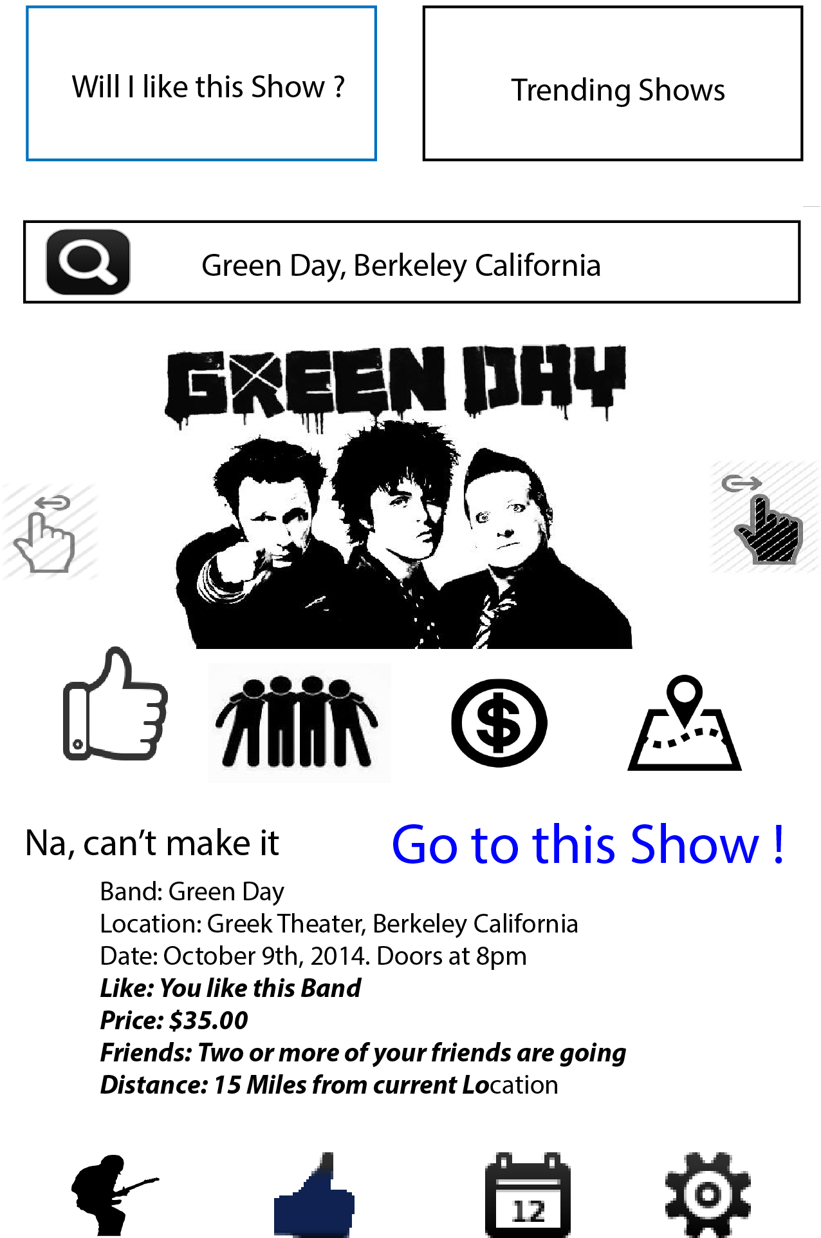
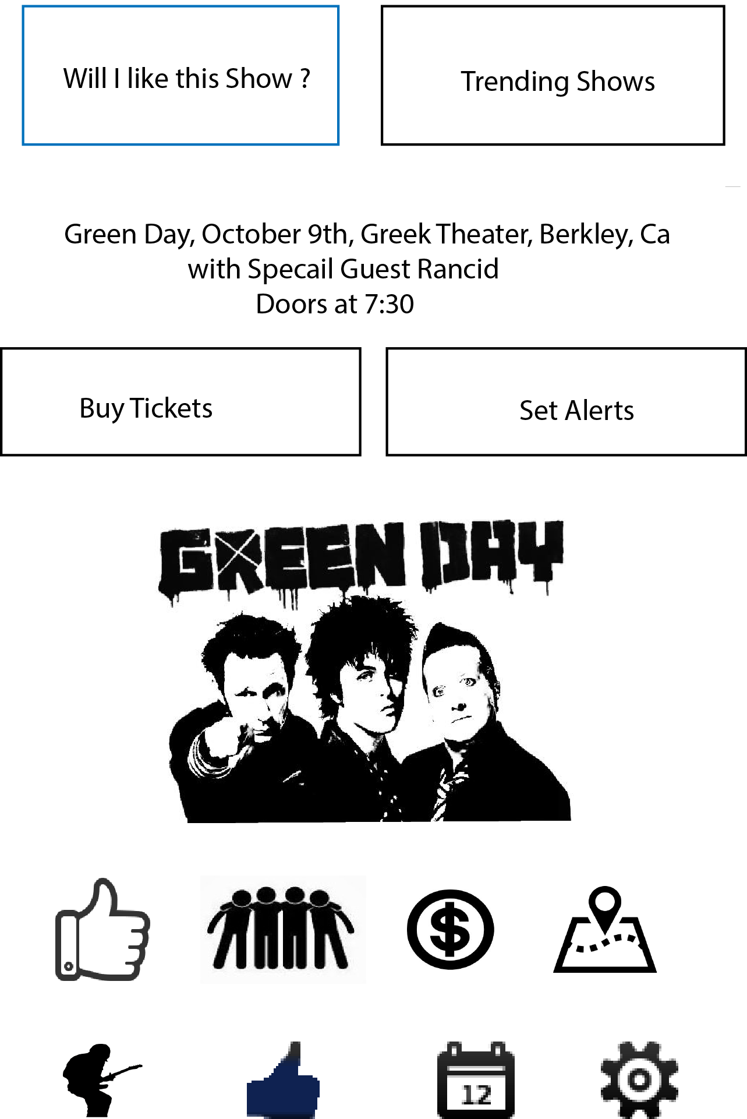
Wire Frames of Key User Flow

Slide 15
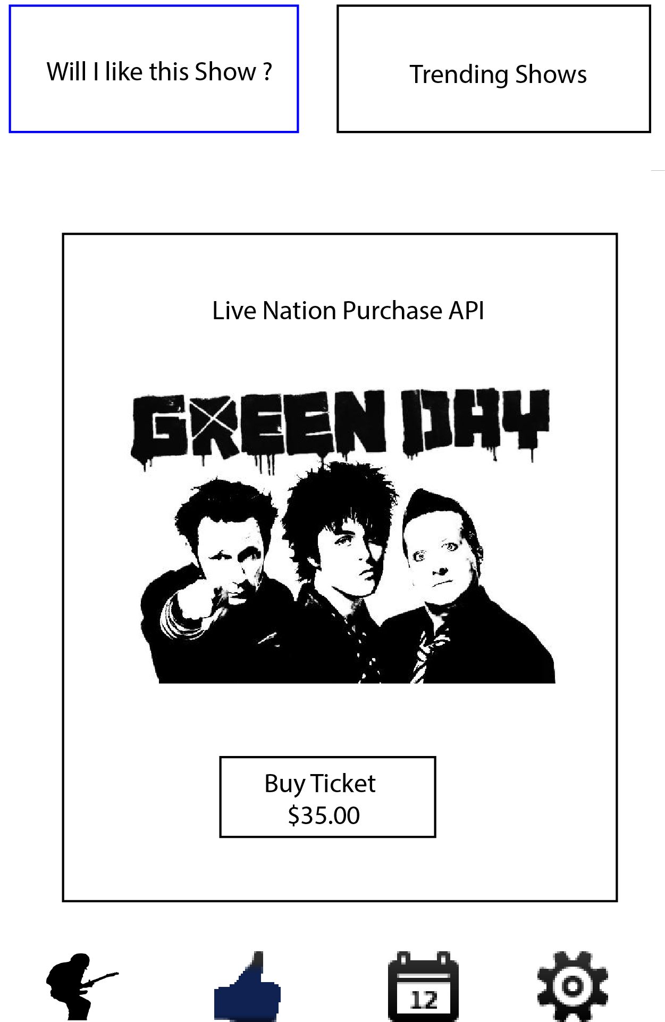
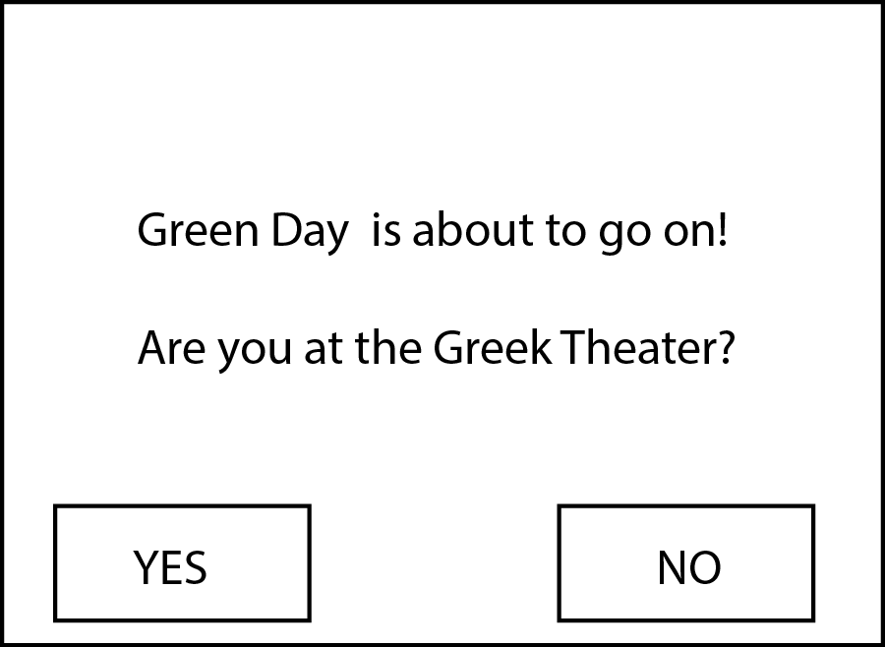
Wire Frames

Slide 16
Dev. Timeline

Slide 17
Business Objectives
Red line represents number of users
Q2 –Q4 2015
Revenue Growth
Profitability
Q1 2015
Refine Product
Extend Customer Channels
Grow user base
Q4 2014
Refine Product +
Grow user base
Q2 2014
Market Research + MVP
Q3 2014
Build Product

Slide 18
Product Road Map
Feature | Benefit to Product | Complexity | Risk | Priority | Version | Start Date | End Date | Duration
Market Research | Preform market research to gain insight into live music market | 3 | 5 | 1 | Vo | 5/1/14 | 5/7/14 | 6
Define Product Hypothesis | Define what needs there are to people who go to live music | 3 | 5 | 1 | Vo | 5/15/14 | 5/17/14 | 2
MVP | This will expose risk and find if there is a product market for an active predictive engine | 2 | 1 | 1 | Vo | 5/18/14 | 5/31/14 | 13
Mobile Application | Platform on which users will interface with CoinFlip | 4 | 3 | 2 | V1 | 6/1/14 | 8/18/14 | 78
Server | Provide Data for the application to interact with | 3 | 3 | 2 | V1 | 6/1/14 | 8/1/14 | 61
Reporting Dev. | Historical reports can be generated automatically without human input | 3 | 3 | 2 | V1 | 8/1/14 | 8/5/14 | 4
Recommendation Engine | Will provide the core feature of the application: to tell users if they are going to like a live concert or not | 1 | 1 | 1 | V1 | 6/1/14 | 12/31/14 | 213
Pre-Launch Marketing | Rise the awareness of the CoinFlip application prior to launch | 2 | 2 | 2 | V1 | 10/1/14 | 12/31/14 | 91
Reporting Publish Reports | These reports will be sold to interested parties | 3 | 3 | 2 | V1 | 1/3/15 | 1/4/15 | 1
Application Launch | Make the application for download on the Mobile store fronts | 5 | 5 | 1 | V1 | 1/3/15 | 1/4/15 | 1
Post- Launch Marketing: Growth | Drive users to download page on the mobile store fronts | 2 | 2 | 1 | V1 | 1/3/15 | 3/1/15 | 57
Application Dev: Refinement and market Growth | Feature refinement to ensure users get the most out of the application | 2 | 2 | 1 | V2 | 1/4/15 | 2/28/15 | 55
Launch v2 of the Application | Push updates to the application aimed at growth | 4 | 4 | 1 | V2 | 3/1/15 | 3/2/15 | 1
Feature Retention and market Growth | Grow Market Share | 2 | 2 | 1 | V2 | 3/1/15 | 7/31/15 | 152
Revenue Growth | Grow Revenue | 2 | 2 | 1 | V3 | 4/20/15 | 12/31/15 | 255

Slide 19
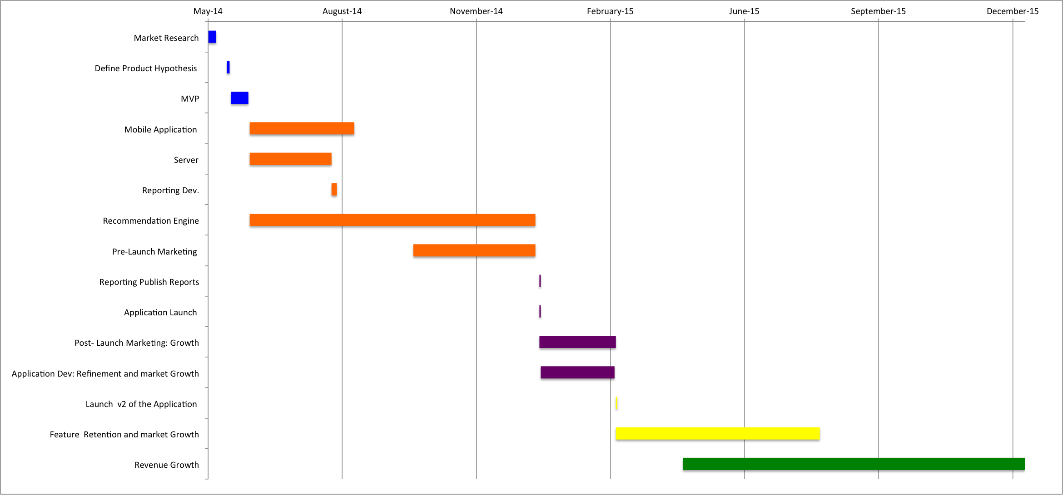
Product Road Map Timeline

Slide 20
Business Metrics
Category | User Status | Target Converstion %
Acquisition | Download from mobile store fronts : Direct Search iTunes and Google Play | 100.0%
Acquisition | Download from mobile store fronts via custom link : From Email Campaign | 4.3%
Acquisition | Download from mobile store fronts via custom link : From Blog Post | 3.0%
Acquisition | Download from mobile store fronts via custom link : From Press Releases | 4.1%
Acquisition | Download from mobile store fronts via custom link : Social Media Campaign | 3.4%
Acquisition | Download from mobile store fronts via custom link: Promotion Product Web Page via SEO | 2.4%
Activation | Launch the Application after download | 75.0%
Activation | Login via social network login | 70.0%
Activation | Login via 30 day Free Trial | 20.0%
Activation | Complete Set Up Wizard to gain users music, location , price point and social network perferences | 50.0%
Activation | Uses the Active Recommendation Engine to see if they will like a specific live show | 30.0%
Activation | Uses the Passive Recommendation Engine to see if they will like any live show around them based on their user preferences | 25.0%
Retention | Uses the Active Recommendation Engine to see if they will like a specific live show more than once a month | 10.0%
Retention | Uses the Passive Recommendation Engine to see if they will like any live show around them based on their user preferences more than once a month | 20.0%
Retention | Bi-Weekly Email Notifications of trending shows in the users area | 10.0%
Retention | Push Notifications to alert users of upcoming shows of their favorite bands | 15.0%
Retention | Push Notifications to alert users of news articles and concert reviews of their favorite bands | 20.0%
Retention | Possitive Press Reviews | 1.9%
Referral | In App Referrals: add functionality to invite other users to use the application | 0.9%
Referral | In App Social Media: add functionality to promote activity on the app to social media to build brand awareness | 1.1%
Referral | Positive Application Reviews | 0.5%
Revenue | Break Even : Percentage of user from the market share to brake even | 0.25%
Revenue | Profit: : Percentage of user from the market share to make a profit | 0.5%

Slide 21
Financial Model
 |  | Y1 | Y2 | Y3
Market Size |  | 18,009,626 | 18,369,818 | 18,737,214
Market share projections: | .5 Percent
 | # of users aquired | 90,048 | 367,396 | 936,861
Fixed Cost:
 | Headcount | 4 | 5 | 6
 | Total cost/overhead /headcount ($) | 100000 | 110000 | 121000
 | Annual growth (%)
 | Misc/other (%) | 0.10 | 0.12 | 0.15
 | Total cost/year ($) | 440,000 | 616,000 | 834,900
Variable Cost:
 | Organic share | 0.5000 | 0.8000 | 1.0000
 | Lead gen share | 0.5000 | 0.2000 | 0.0000
 | Biz dev share | 0.0000 | 0.0000 | 0.0000
 | Organic cpa | 0.0000 | 0.0000 | 0.0000
 | Leadgen cpa | 1.7900 | 1.9000 | 2.0000
 | Bizdev cpa | 1.5000 | 1.3000 | 1.2000
 | Effective CPA | 0.8950 | 0.3800 | 0.0000
 | Ops cost/user | 0.0010 | 0.0007 | 0.0005
 | TOTAL variable cost/user | 0.8960 | 0.3807 | 0.0005
Profit/Lost |  | Y1 | Y2 | Y3
 | Revenue | $360,192.51 | $1,469,585.44 | $3,747,442.88
 | Acquisiton cost | -$80,683.12 | -$139,867.79 | -$468.43
 | Fixed cost | -$440,000.00 | -$616,000.00 | -$834,900.00
 | Profit/Loss | -$160,490.61 | $713,717.65 | $2,912,074.45

Slide 22
Financial Model cont.
Key Points
2 dollars per user for the life time the use the application
Profitably with great than .25% market share in the second year operation
Revenue Streams:
- Selling of user behavior to interested parties
- Selling data to concert promoters
- Licensing of the A. R. E algorithm
- In application ADS
Investment Capital: Will you be my Angle?
An initial investment of 2 MM

